Slide 1
Twitter Sentiment Analysis for Stock Price Forecast in Technology Industry
-A Study on Microsoft, Tesla and Netflix
04/25/2019
Mingyuhui Liu (Jane)
Instructor: Professor David Broniatowski

Slide 2
Overview
Inrtoduction:
Problem and Question; Constructs; Previous Studies
Methodologies:
Sampling: Sampling Process, External Validity
Measurement: Construct and Operationalization; Reliability and Validity
Model Construction
Analysis and Results

Slide 3
introduction

Slide 4
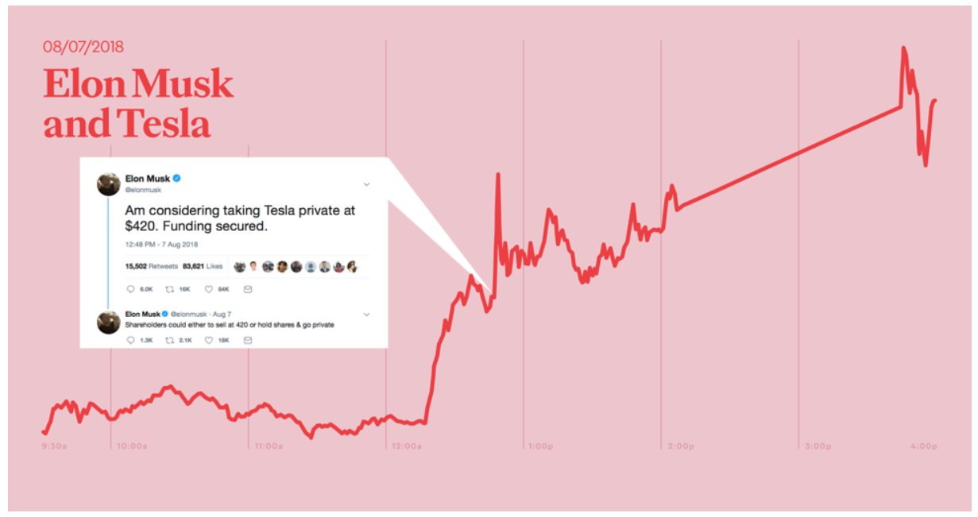
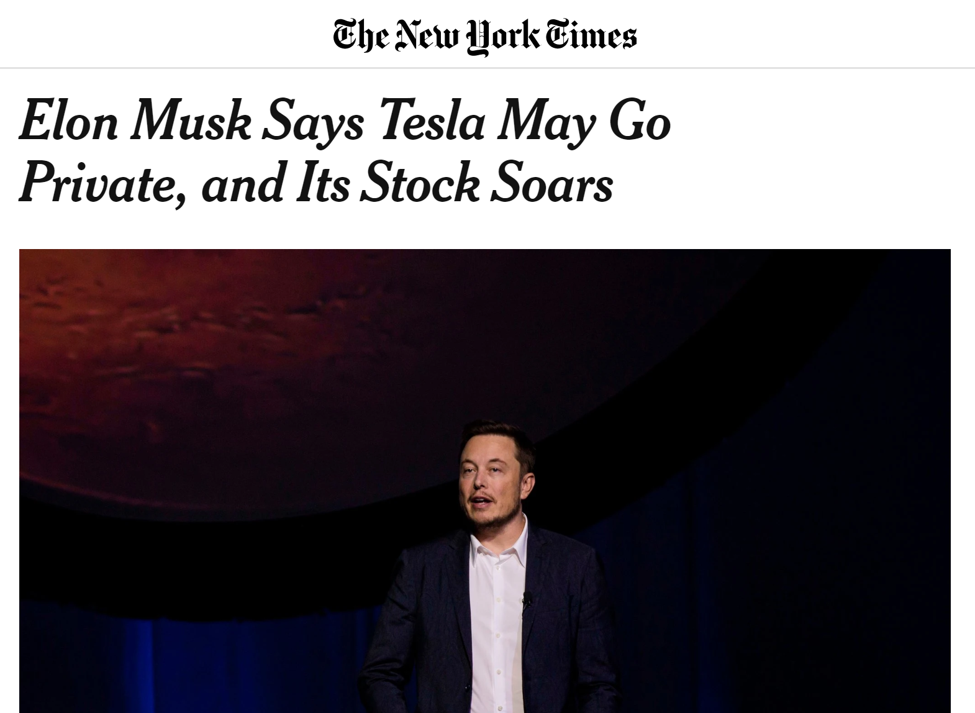
Problem
Figure 1. Elon Musk’s Twitter impacted Tesla stocks on Aug 7, 2018. Adapted from “11 Tweets that Turned the Stock Market Upside Down” by Adam Kornblum, 2018, retrieved from https://www.ogilvy.com
Notes:
https://www.ogilvy.com/feed/11-tweets-that-turned-the-stock-market-upside-down/

Slide 5
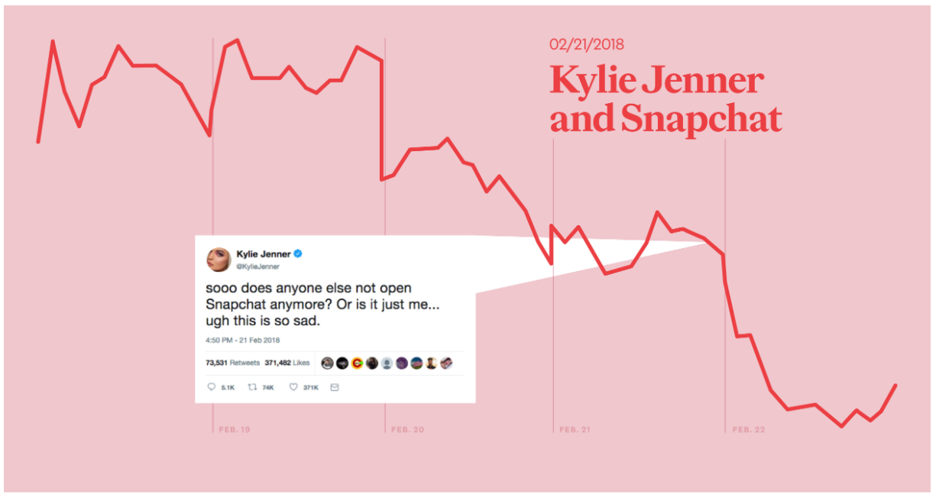
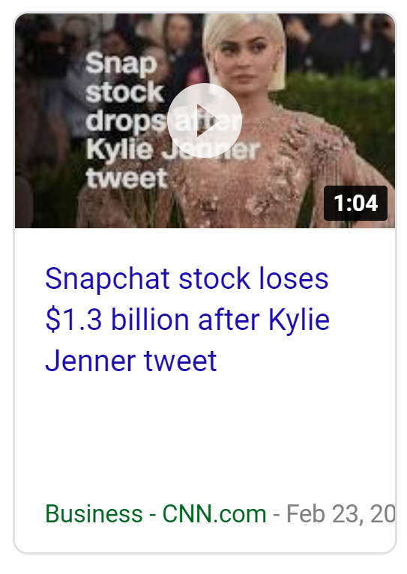
Problem
Figure 2. Kylie Jenner’s Twitter impacted the stock price for Snapchat on Feb 21, 2018. Adapted from “11 Tweets that Turned the Stock Market Upside Down” by Adam Kornblum, 2018, retrieved from https://www.ogilvy.com
Notes:
This has become a common sense that when someone influencial said things about a company on social media, the stock price from that company is going to change. And it is also a common sense that stock prices mainly reflect the confidence level of public investors’ in the company’s future performance. Put these common senses together, it is safe to argue that the aggregated public sentiment extracted from social media may represent the public confidence towards a company, which further influence its stock prices. That being said, by analyzing social media trends and monitoring public opinion of companies we can possibly build a predictive model and anticipate changes in the market before they happen. And together with my personal interest in technology companies, this brings up my research question.

Slide 6

question
Can social media be used to predict technology companies’ stock prices movement?
=> What model can I construct to predict stock prices in NASDQ 100 with Twitter?
What is Twitter
Twitter is an online news and social networking site where people communicate in short messages called tweets.
On average, 6000 tweets are twitted per second, 500 million per day. (http://www.internetlivestats.com/twitter-statistics/ )
What is Nasdaq 100
A pool of 100 largest non-finance companies that are traded in NASDAQ.
Notes:
This is how the problem is narrowed down to such question.

Slide 7
Constructs and hypothesis
Construct:
Public market sentiment & stock market movement for technology companies
Operationalization:
Public Sentiment is measured by agreggated twitter sentiment in a designated time period
Stock market price movement is measured by stock price changes for targeted companies in NASDAQ 100.
Proposed hypothesized relationship:
Change in Twitter Sentiment about a technology company has certain predictive power on their stock performances.
Notes:
This hypothesis has always been popular among researchers.

Slide 8
Previous studies
Always a heating topic among Financial Behavior Researchers…
Kenneth L. Fisher and Meir Statman (2000) used a weekly sentiment survey from July 1987 to July 1995 to measure individual investors sentiment, and found a statistically significant negative relationship between the sentiment level of individual investors and S&P 500 returns in the following month.
Bollen et al. (2010) have shown that when the overall mood extracted from Twitter is calm or happy, statistically significant evidence can be found for an associated reaction of the DJIA a few days afterwards.
Sprenger et al. (2013) focus on ticker-tagged tweets (for example, $TSLA) and find a correlation betweenTwitter sentiment and returns.
Michael Ofer and Oliver Hinz (2015) harvested public mood from Twitter in Germany, and found that only when taking number of followers into consideration would they be able to use Twitter mood to predict stock returns.
Instead of predicting market index with general moods, this research focused more on a generalized methodology to predict individual stocks with tweets that targeting at these companies.
Notes:
As early as the year of 2000, researchers have discovered statistically significant relationship between sentiment level of individual investors and S&P 500 returns by invstigating weekly surveys from newpaper. And when social media became a hit, researchers from 2010s found that they were able to use general mood extraced from Twitter to predict other index such as Dow Jones Industrial indicator. And compmared to the previous studies,

Slide 9
methodologies
Sampling

Slide 10
sampling
Theoretical Population
Accessible Population
Sampling Frame
Sample
Data-point
All technology stock’s sentiments and all technology stocks.
Sentiments of stocks that were twitted about.
Twitter collection with key words from SFM & selected Nasdaq 100 from Alpha Vantage API
Tweets collected from SFM & stock prices from Alpha Vantage API
Aggregated sentiment from the collection of tweets and stock price changes in 5-min intervals
Notes:
Now I am going to talk about specifically the sampling frame, as in how will I reach my samples. Firstly, I choose my target companies.

Slide 11
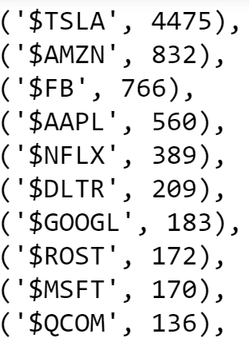
Choosing target companies
Collected 2 days (Oct 30~31, 2018) of data over 103 companies CashTag “$TICKER”:
More than 21,300 collected.
Chose 3 companies:
Microsoft
Tesla
Netflix
Figure 3. Cash ticker top 10 mentioning in NASDAQ100.
Notes:
In order to choose target companies, the first thing is I wanted to make sure that the companies I chose are regularly mentioned or commented in Twitter. Therefore, I collected 2 days of data with only the cashtags of all the NASDAQ 100 companies, and counted how many times each cashtags were mentioned.
Now I have the list, I would also like to make sure the chosen companies names are unique.

Slide 12
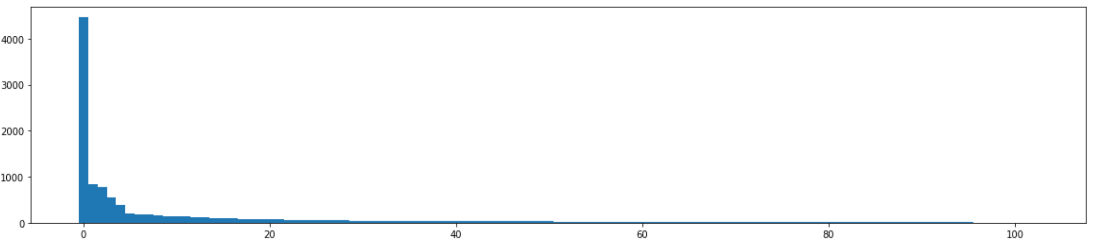
Sampling process
Scope and Keyword Lists
3 chosen companies have more than 45% of all the mentions for Nasdaq 100 in Twitter. (Do not overclaim here)
Mentions
Companies
Figure 4. Cash ticker mentioning ranking histogram for 103 companies in NASDAQ100.
Notes:
They are relatively good representations of the Nasdaq 100.
Another important sampling frame is the keyword list I used to collect relevant tweets. (Do not overclaim here)

Slide 13
Sampling process
Keyword List:
#Microsoft , #microsoft , #MSFT , #msft , $MSFT
#Netflix , #netflix , #NFLX , #nflx , $NFLX
#Tesla , #tesla , #TSLA , #tsla , $TSLA

Slide 14
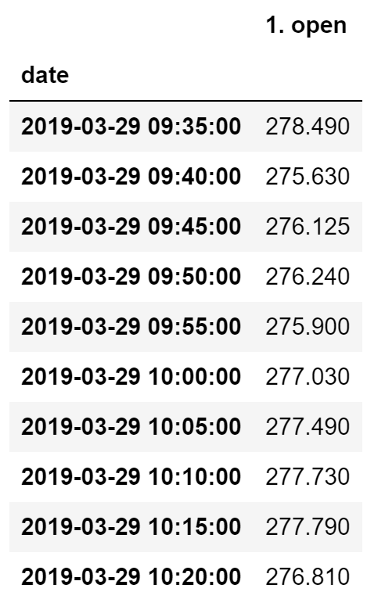
Sampling process
Stock Prices:
For 5-minutes stock prices, 78 (12*6.5hr) data points can be collected for each business day
Table 1. Tesla prices in 5-minutes’ intervals on March 29, 2019.

Slide 15
methodologies
Measurement

Slide 16
Construct
Construct | Operationalization | Detailed Plan
Public Sentiment | Twitter sentiment analysis | Collect relevant tweets from SFM; Sentiment analysis (vader and textblob)
Stock Price Movement | Stock price changes. | Use Alpha Vintage API to collect stock price with 5-min intervals; Calculate changes in stock prices.
Table 2. Construct, operationalization and detailed plan for measurement.
Notes:
Here I want to talk a bit more about the sentiment analysis.

Slide 17
Sentiment analysis
Textblob:
Approach 1(T1): Set up a threshold for polarity scores to label -1, 0, and 1.
Approach 2 (T2): Polarity scores
Vader:
Approach 1 (V1): Set up a threshold.
Approach 2 (V2): Scores
Notes:
Originally, both Vader and Textblob return a polarity score on the continuous range from -1 and 1, denoting the general mood from a sentence. At the meantime we also know that more than often, merely the three categories of negative, neutral and positive are enough. Therefore, I constructed models with all 4 approaches. 2 from each. For example T1 represents the method with Textblob and a cut-off threshold to convert polarity scores into -1, 0 and 1.
And this will bring the problem of validity.
Recall on -1, so I wont miss price drops.

Slide 18
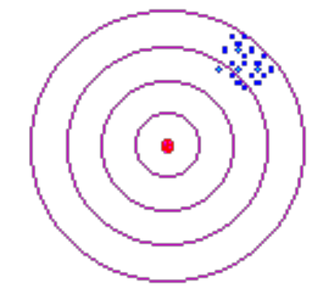
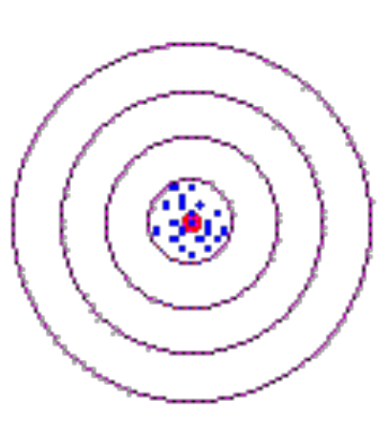
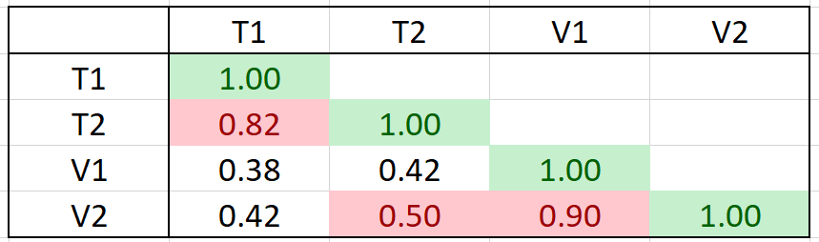
validity
Vs.
Construct:
Market Sentiment
Measurment
Twitter Sentiment scores:
Ratio
Convergent Validity: Correlations of all measurements
Table 3.Corellations of the ratios measuring aggregated sentiment.
Notes:
The scores in red suggests that the convergent validity was good enough to carry on the research.

Slide 19
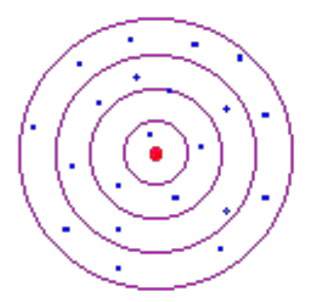
Reliability
Vs
Construct:
Market Sentiment
Measurment
Twitter Sentiment scores:
Ratio
Reliability:
Test-retest reliability: multiple days’ of data. (data)
Notes:
Since the stock price changes are derived from the real stock prices, so the measurement is measuring the truth. Therefore the main focus on this part is for the measurement of the market sentiment.
Need to explain vader and textblob

Slide 20
methodologies
Design

Slide 21
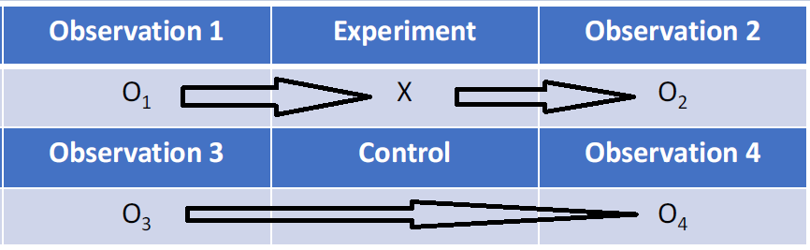
design
Pretest-posttest design with a control group (quasi)
Also addressed Historical Confound.
Baseline Model
Figure 5. Pretest-posttest design with a control group.
Notes:
By adding a control group, the main internal validity threat to the research – Historical Confound – were also addressed. With a control group without sentiment, the research were able to examine only the effects of sentiment other than the alternatives

Slide 22
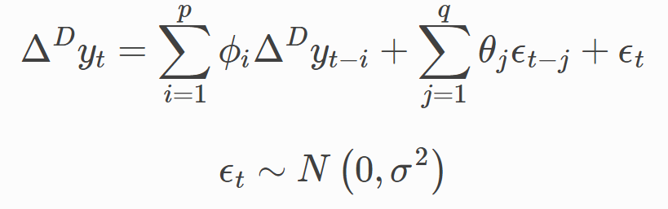
Model construction
Baseline model: Autoregressive Integrated Moving Average(ARIMA)
parameters:
P - The number of lag observations included in the model;
D - Degree of differencing;
Q - The order of moving average.
Tuned

Slide 23
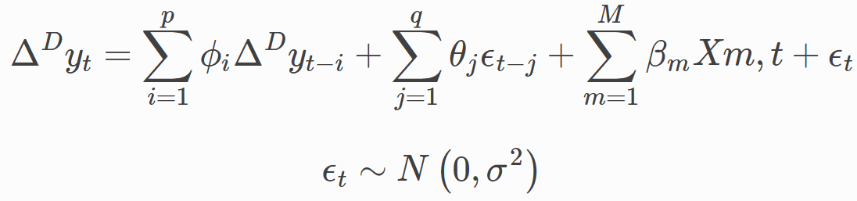
Model construction
ARIMAX: ARIMA with exogenous (independent) variable(s).
Python Package: Pyflux.

Slide 24
Model construction
Proposed Model:
Intraday data has 5 mins intervals, while the time between the closing price and opening price is 15.5 hrs (weekends are even longer).
Therefore, I need different models for intraday and the inter-day data.

Slide 25
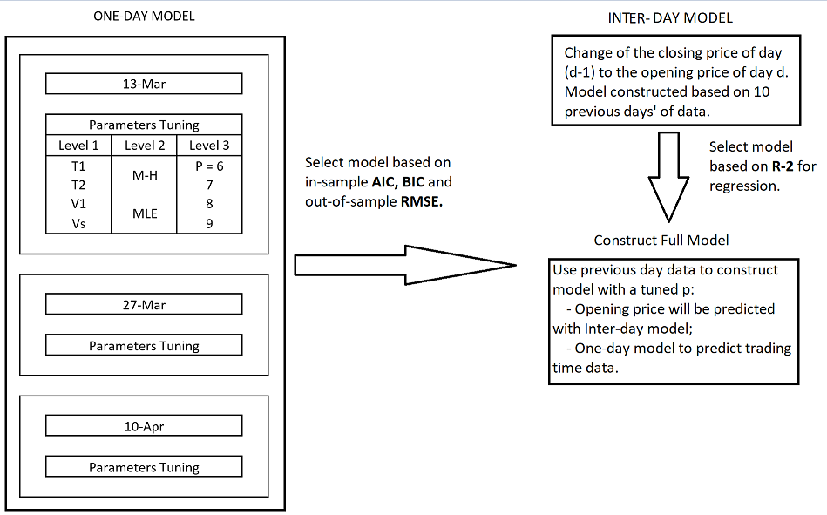
Figure 6. Model construction.
Notes:
First the general idea was….
Then in the one day model, I chose three days that span on a long-time period, since I wanted to eliminate or control of the effects from some uncalculated external events.
On level 2, PyFlux gave me the choice to fit the arima and arimax model with Metropolis-Hastings or Maximum likelihood.

Slide 26
Analysis and discussion
Microsoft, Tesla and Netflix: Mar 27 ~ April 11.
Notes:
12 trading days.

Slide 27
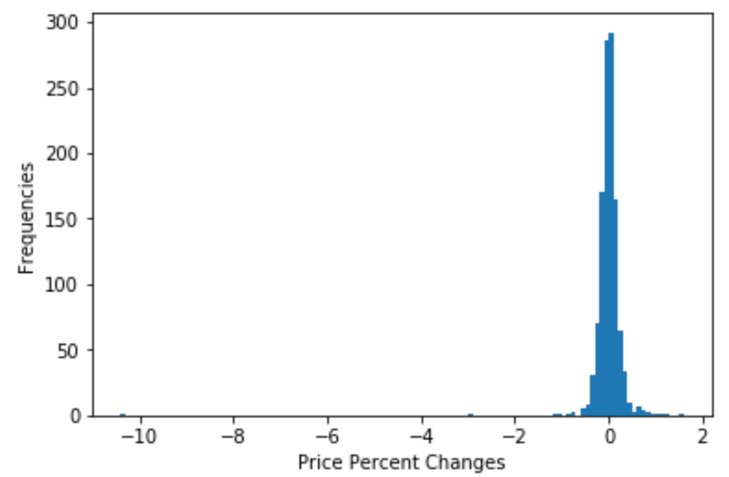
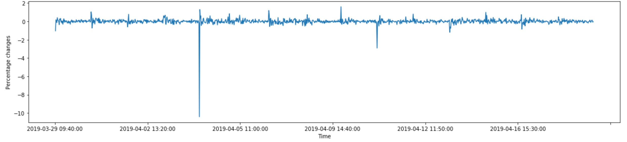
descriptive stats: TSLA
Mean: -0.001%
Std: 0.38
Min: -10.4%
Median: 0.004%
Max: 1.6%
Figure 7. Histogram of price percent changes for Tesla.
More than 10% drop at the opening on April 4, 2019. This was due to the reporting of the biggest sales drop (31%) the day before.
Figure 8. Percent changes over time for Tesla.
Notes:
More than 10% decrease at 2019-04-04 opening price.

Slide 28
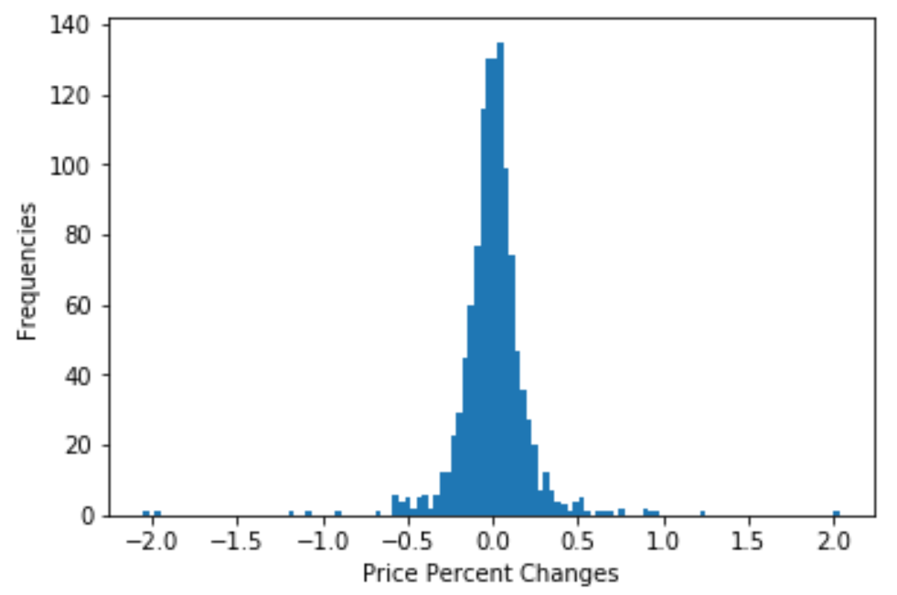
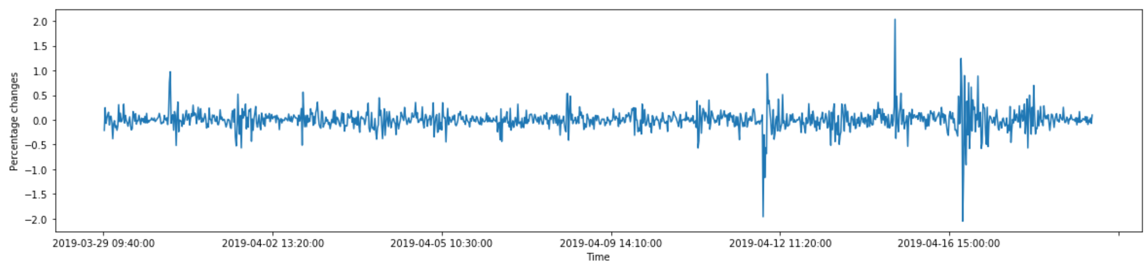
descriptive stats: NFLX
Mean: 0.001%
Std: 0.21
Min: -2.05%
Median: 0.003%
Max: 2.03%
Figure 11. Histogram of price percent changes for NFLX.
Disney announced a new streaming service that is cheaper than Netflix on April 16, 2019.
Figure 12. Percent changes over time for NFLX.

Slide 29
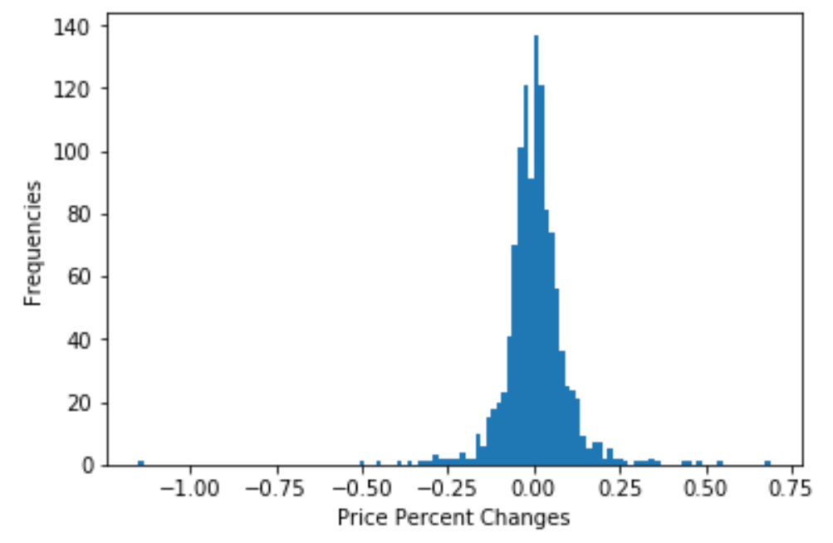
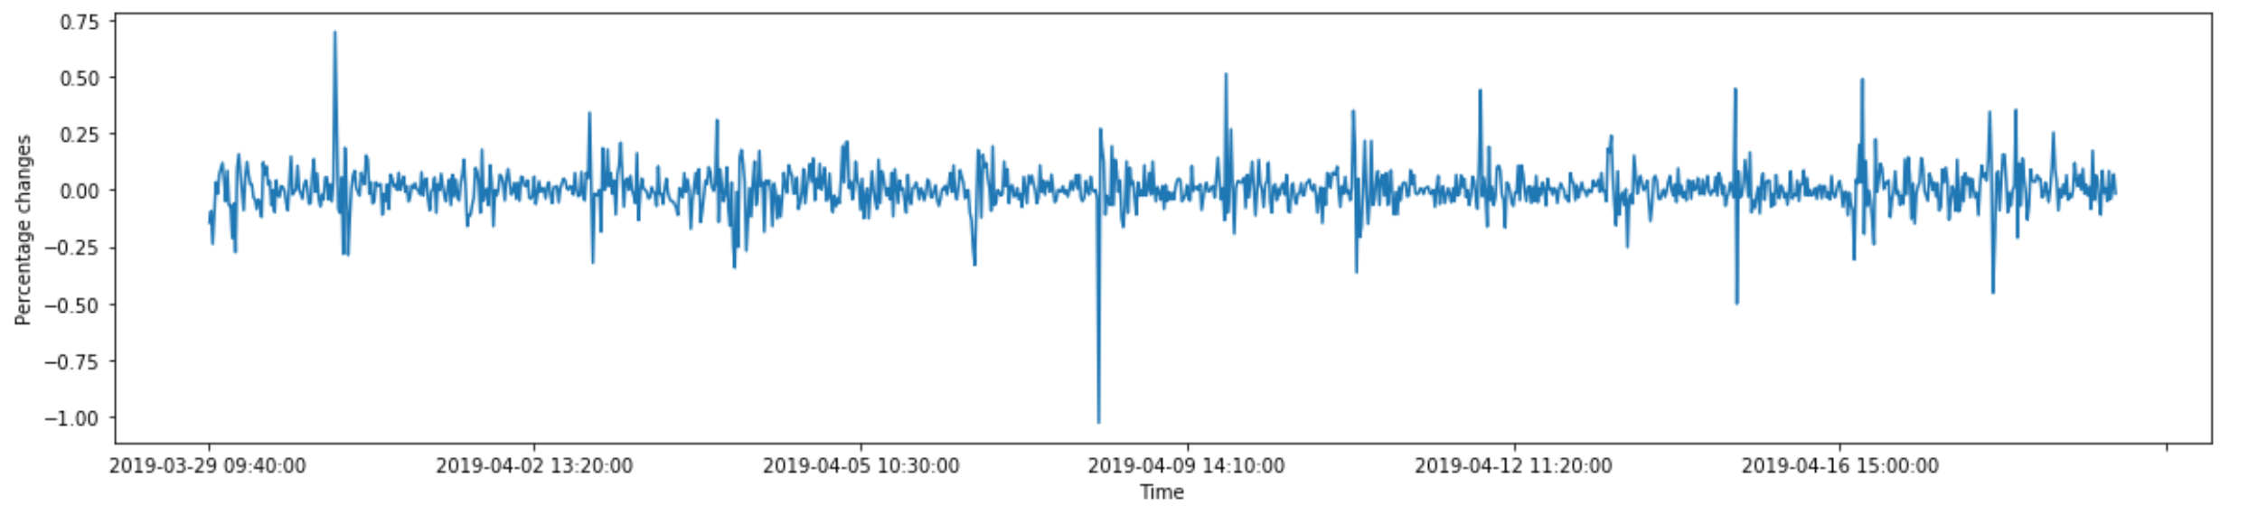
descriptive stats: MSFT
Mean: 0.004%
Std: 0.1
Min: -1.15%
Median: 0
Max: 0.69%
Figure 9. Histogram of price percent changes for Microsoft.
Figure 10. Percent changes over time for Microsoft.

Slide 30
Descriptive Stats: Takeaways
MSFT has the minimum std, and has relatively constant performances. Therefore, I used MSFT as a base company to construct models.

Slide 31
MSFT: Modeling results
Table 5. Baseline model results.
Table 4. Results comparisons of model constructions.

Slide 32
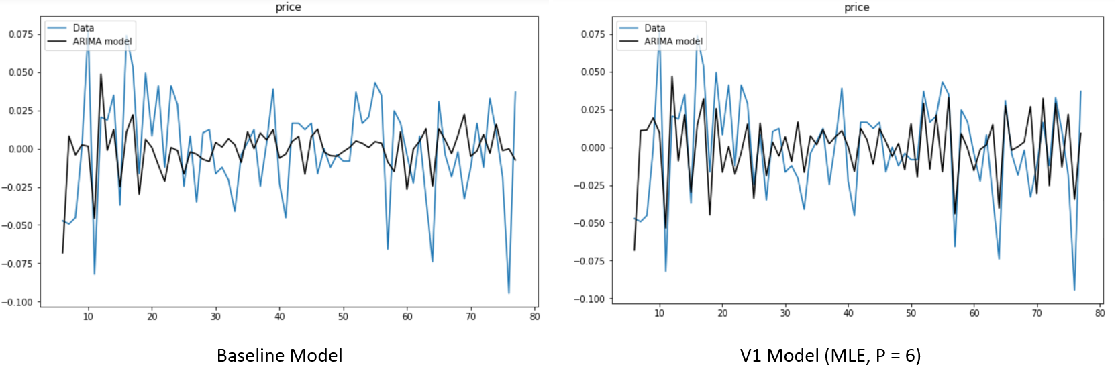
One-day model
Figure 13. Baseline model vs V1 model fitting plot with data from March 13, 2019.
Notes:
This is in-sample fitting plot.

Slide 33
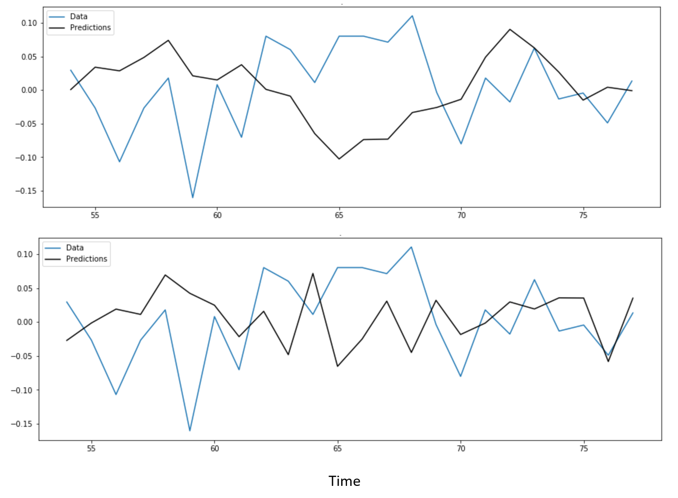
Out of sample pred vs true
Baseline Model
V2 Model
Figure 14. Out of sample prediction vs true plots for Baseline Model and V2 Model on data from April 10, 2019.

Slide 34
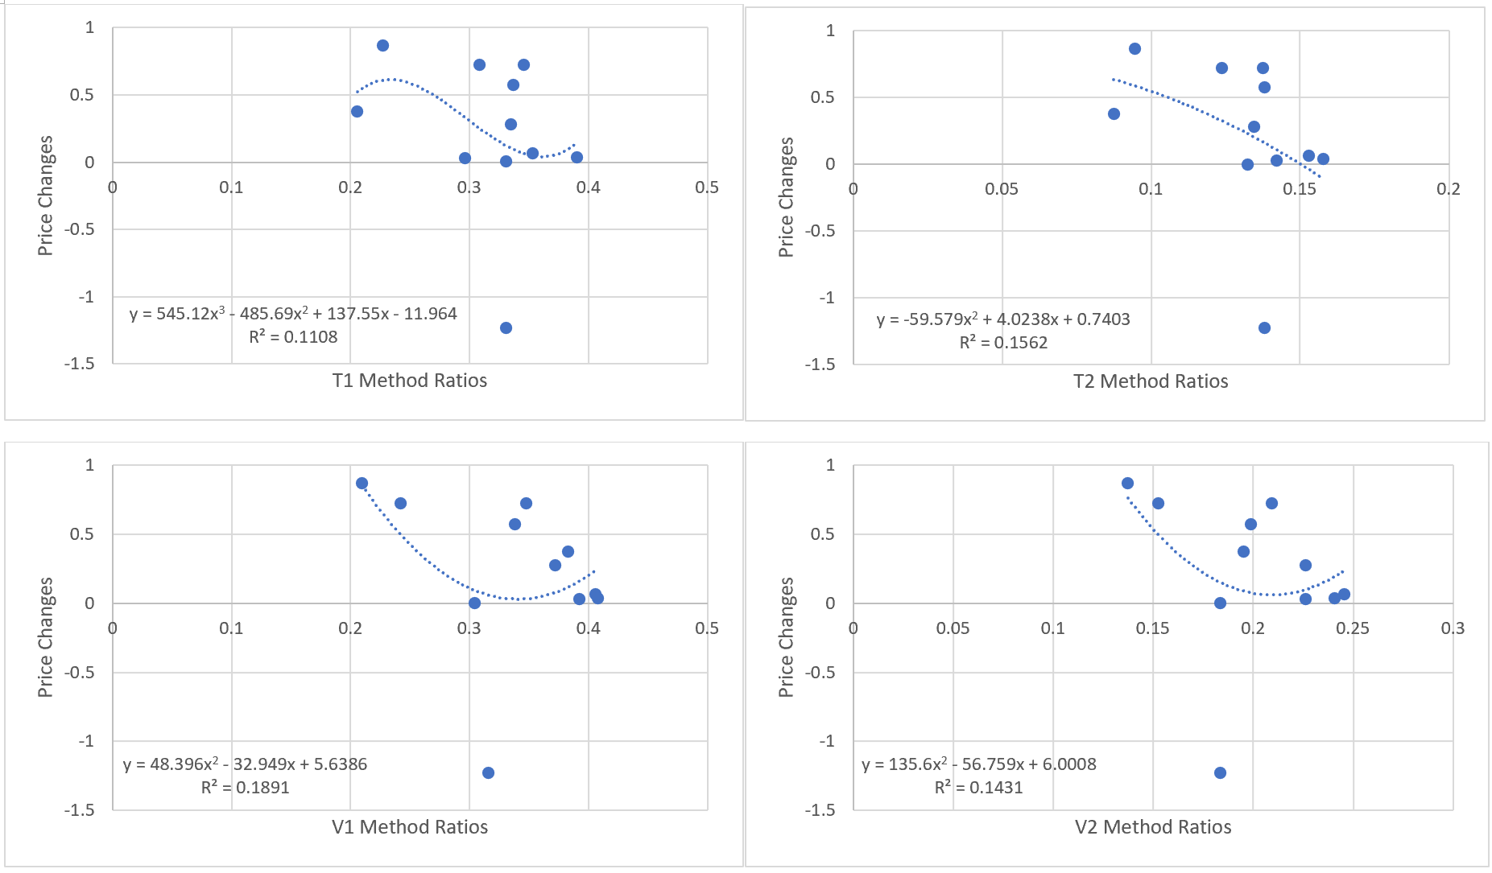
Inter-day model construction
V1 was chosen
Figure 15. Inter-day sentiment measurements vs price changes.

Slide 35
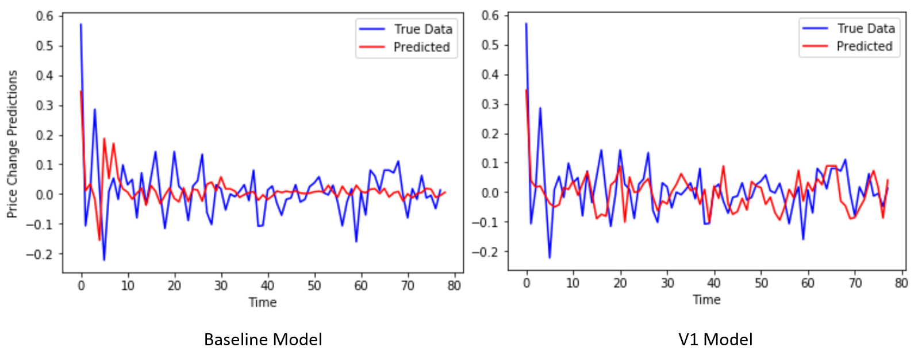
Baseline model vs Full model
RMSE: 0.113
RMSE: 0.085
Figure 16. Baseline model vs full model on true data vs predicted values, using 04/10 data to predict 04/11.

Slide 36
Pred vs true RMSE comparison
Table 6. Baseline model vs full model on true data vs predicted values by RMSE.

Slide 37
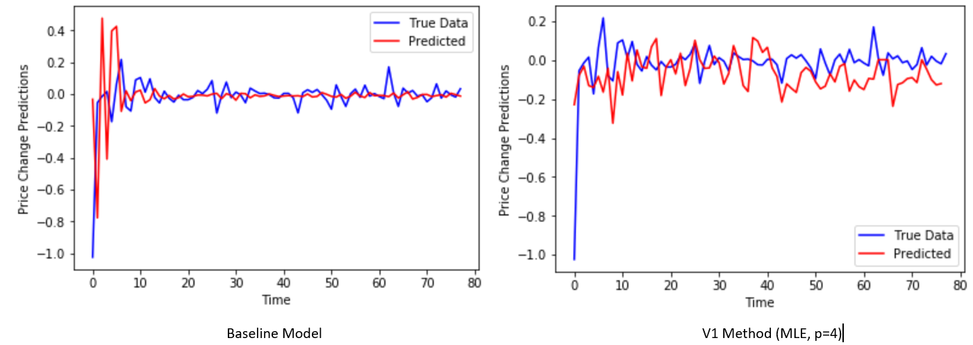
Tesla Full model result
Figure 17. Tesla baseline model vs full model on true data vs predicted values, using 04/10/2019 to predict stock price changes on 04/11/2019.

Slide 38
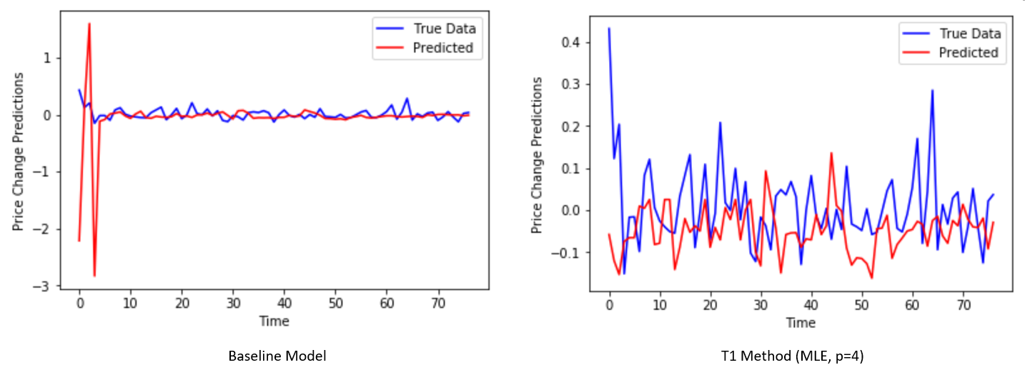
netflix full model results
Figure 18. Netflix baseline model vs full model prediction, using 04/03/2019 to predict stock price changes on 04/04/2019.

Slide 39
3 companies results
Table 7. Baseline model vs full model results for all targeted companies.

Slide 40
Conclusion and discussion

Slide 41
conclusion
By adding public sentiment extracted from Twitter into the time-series model, the proposed method can improve the forecast of the stock price changes in targeted companies.

Slide 42
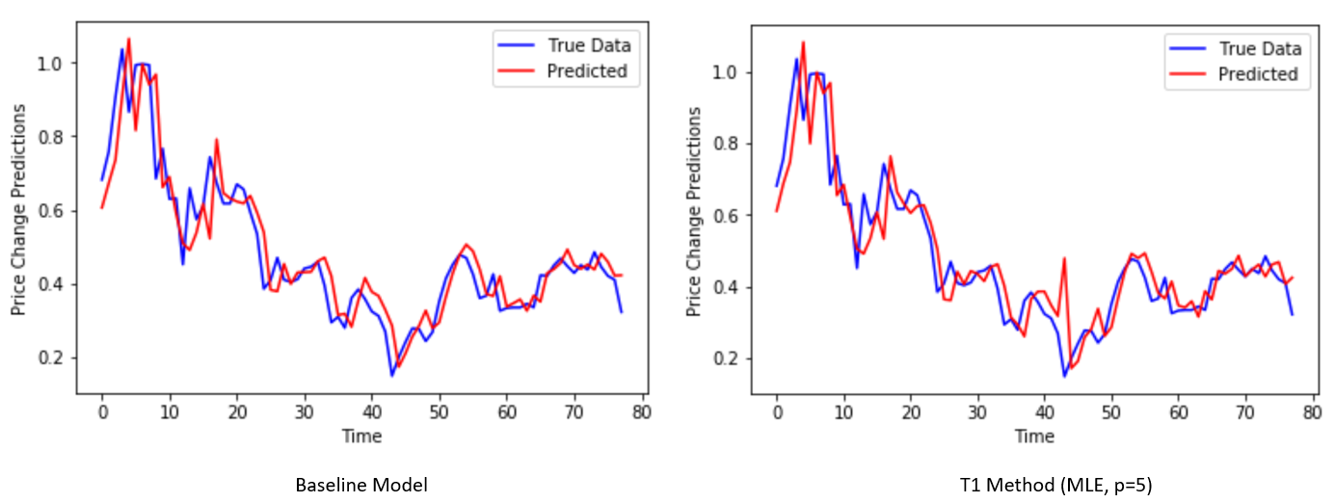
however
Figure 19. Netflix baseline model vs full model prediction, using 04/10/2019 to predict stock price changes on 04/11/2019.

Slide 43
discussion
Compared to Tesla and Microsoft, Netflix’s had a more accurate baseline model, and in that case, the proposed method failed to improve the performance any further.
Further classification can be done if only interested in short-time ups and downs.
Other explanatory variables such as popularity, can be added to the model

Slide 44
Thank you!

Slide 45
Reference
T. Nath. “Investing basics: what is the Efficient Market Hypothesis, and what are its shortcomings?” 2015. [Online]. Available: https://www.nasdaq.com
Nasdaq Inc. “Nasdaq-100 Index Methodology,” 2018. [Online]. Available: https://www.nasdaq.com/markets/indices/nasdaq-100.aspx [Accessed: Dec. 9, 2018].
Internet Live Stats. “Twitter Usage Statistics,” [Online]. Available: http://www.internetlivestats.com/ [Accessed : Dec. 6, 2018].
A. N. Smith, E. Fischer, Y. Chen . “How does brand-related user-generated content differ across Youtube, Facebook and twitter?” J Interact Market, vol. 26, pp. 102-113, March 2012.
S. L. Heston, N. R. Sinha. “News vs. Sentiment: Predicting Stock Returns from News Stories,” Financial Analyst Journal, CFA Institue, vol. 73, no. 3, 2017.
J. Bollen, H. Mao. “Twitter mood predicts the stock market,” Journal of Computer Science, vol. 2(1), pp. 1-8, 2010
M. Ofer, O. Hinz. “Using Twitter to Predict the Stock Market: Where is the Mood Effect?” Bus Inf Syst Eng, vol. 57(4), pp. 229–242, 2015
T. O. Sprenger, A. Tumasjan, P. G. Sandner, I. M. Welpe. “Tweets and trades: the information content of stock microblogs,” Eur Financ Manag, vol. 20(5), pp. 926–957, 2013
Alpha Vantage Inc. Alpha Vantage API Documentation. [Online]. Available : https://www.alphavantage.co/documentation/ [Accessed : Oct. 26, 2018].

Slide 46
Pre-market trading
https://www.quora.com/How-is-the-NSE-BSE-Stock-open-Price-determined

Slide 47
Reliability
Vs
Construct:
Stock Price Changes
Measurment
Standardized price changes
Percentage changes
Reliability:
Test-retest reliability: multiple days’ of data.
Parallel-form reliability: correlations of the two measurements.

Slide 48
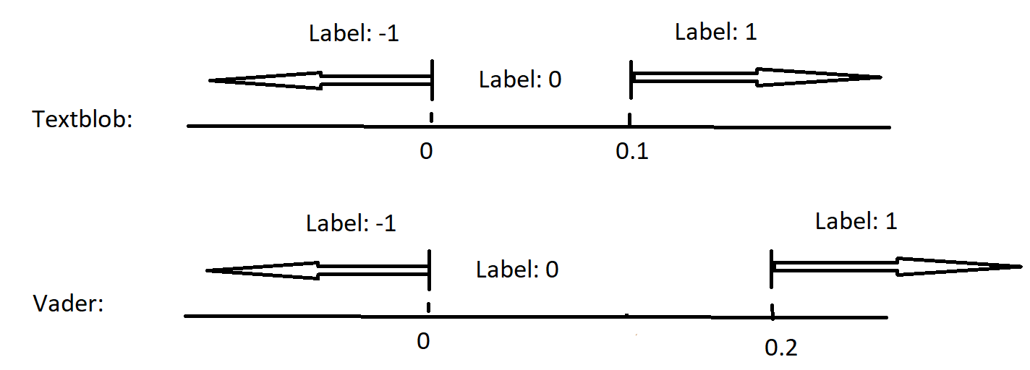
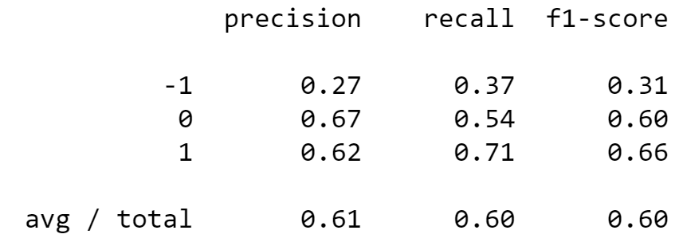
Sentiment analysis
Thresholds are tuned with precision, recall and F1 score:
Table 3. Precision, recall and F-1 score of the chosen thresholds.
Figure 4. Illustration of the thresholds.
Notes:
Recall on -1, so I wont miss price drops.

Slide 49
Sentiment analysis
Lexicon Dictionary:
Vader (rule-based), which takes into consideration of:
sentiment intensity: Punctuation (“!!!”); intensity booster (“very”); emphasis (“ALL CAPS”)
Sentiment-laden slangs: “sux”, “frigging”, “kinda”, etc.
Emoticons and emojis: :), :D, 💘 and 💋 and 😁
Vader: polarity scores from -1 to 1.
Vader approach 1: when score < -0.5, assign -1; when score > 0.5, assign 1, otherwise assign 0;
Vader approach 2: use the polarity scores directly.

Slide 50
Sentiment analysis
Machine Learning:
Textblob (NLTK with Bayesian Classifier)
SentiStrength (Builds a lexicon dictionary annotated by humans and improved with the use of Machine Learning)
Stanford Recursive Deep Model (also take the order of word into consideration)

Slide 51
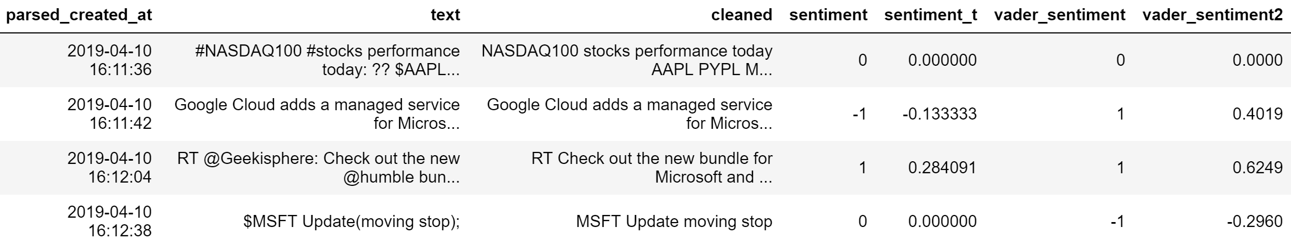
MSFT mention
Notes:
Use (log + 1) to meet the normality assumption.
Or see whether 0 or non-0 will affect the price.

Slide 52
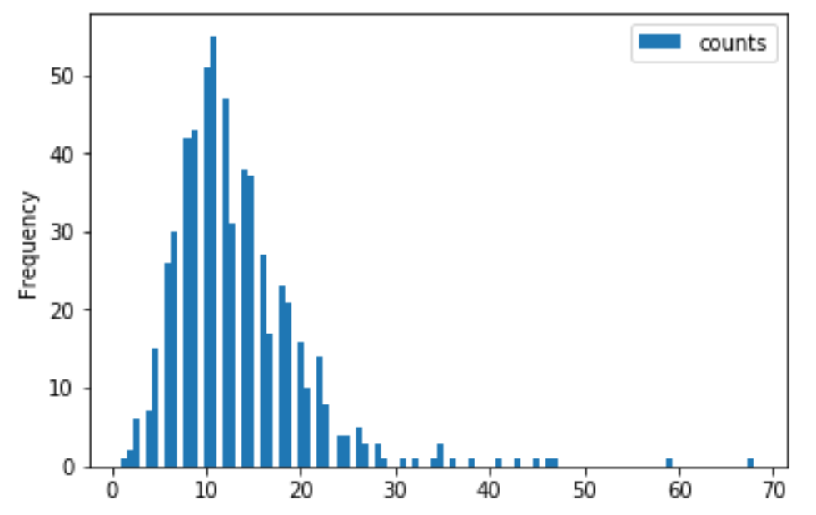
Twitter mentions
MSFT mentioning in a 5-minutes’ intervals :

Slide 53
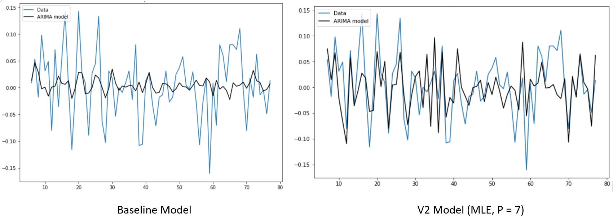
One-day model
Figure . Baseline model vs V2 method with data from April 10, 2019.

Slide 54
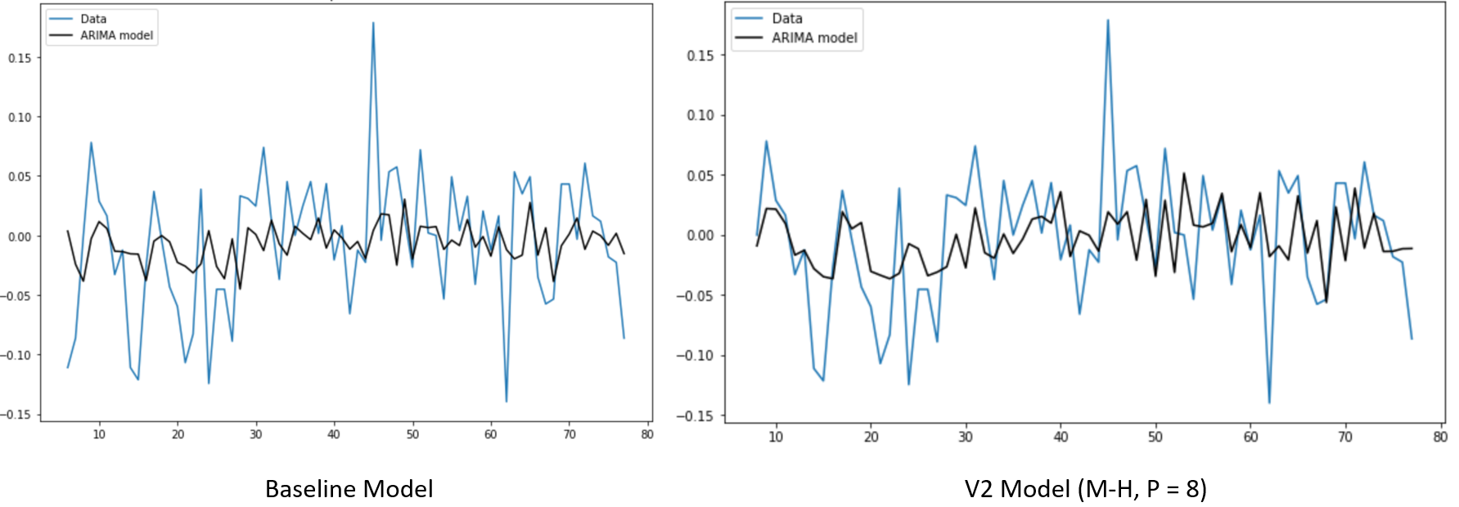
One-day model
Figure . Baseline model vs V2 method with data from March 27, 2019.

Slide 55
Tesla interday model
Inter-day:

Slide 56
netflix interday model
Inter-day:

